Slide 1

Tel : +353 53 9161786 Email info@bakugls.com

Slide 2
Our Annual Gender Pay Gap Report
CONTENTS
Introduction – First Study
What is Gender Pay Gap
The Data
Employee Profile
Gender Pay Gap Fields
Data Interpretation
Action Plan
Commitment

Slide 3
Gender Pay Gap
2024-2025
Reporting period: 1 July 2024 to 30 June 2025.
This is the first Gender Pay Gap study and analysis conducted by Baku GLS in accordance with current legislation.
While our gender pay gap reflects some of the broader trends within the transport industry, we are dedicated to challenging these norms, promoting diversity at all levels of the organisation and creating pathways for women to develop in traditionally underrepresented roles.

Slide 4
What is
Gender Pay Gap
Gender pay gap is the difference in the average gross hourly pay of women compared with men in a particular organisation, regardless of the nature of their work.
It is expressed as a percentage of men’s pay. The gender pay gap captures whether women are represented evenly across an organisation.
The gender pay gap should not be confused with the concept of equal pay for equal work. The existence of a gender pay gap does not necessarily mean that women are not receiving equal pay.

Slide 5
The Data
Reporting period: 1 July 2024 to 30 June 2025.
Employee Profile
Gender | No. of FT Employees | % of FT Employees | No. of PT Employees | % of PT Employees | Total No. of Employees | % of Total Employees
Male | 120 | 86% | 1 | 25% | 121 | 85%
Women | 18 | 14% | 3 | 75% | 21 | 15%
All | 138 |  | 4 |  | 142
One Company – One Solution

Slide 6
The Data
Reporting period: 1 July 2024 to 30 June 2025.
Gender Pay Gap Fields |  | June 2025
1 | Mean hourly gender pay gap (all) | -15.9%
2 | Mean hourly gender pay gap (part time) | -60.8%
3 | Median hourly gender pay gap (all) | -20.8%
4 | Median hourly gender pay gap (part time) | -64.8%
5 | Mean hourly performance related bonus gender pay gap | -240%
6 | Median hourly performance related bonus gender pay gap | 0%
7 | Percentage of employees per gender to receive a performance related bonus remuneration | 86% (F) 94% (M)
8 | Percentage of employees per gender to receive Benefit in kind | 5% (F) 2% (M)
9 | Percentage of employees within lower remuneration quartile | 80% (M) 20% (F)
10 | Percentage of employees within lower middle remuneration quartile | 91% (M) 9% (F)
11 | Percentage of employees within upper middle remuneration quartile | 100% (M)
12 | Percentage of employees within upper remuneration quartile | 69% (M) 31% (F)
One Company – One Solution

Slide 7
Data Interpretation
Primary Reasons for the Pay Gap
Significant lower level of female participation in the transportation industry.
Our operation requires a lot of historically male dominated skills such as HGV Drivers, Mechanics and Warehouse personnel.
As the majority of driving staff are male and work longer hours (due to the nature of HGV driving/work), the calculation reduces the hourly rate which also widens the gap.
One Company – One Solution

Slide 8
Action Plan
Due to the challenge that a full employment market brings we need to focus our recruitment process to ensure it is promoting inclusion, objectivity and consistency across all recruitment activities.
Our remuneration policies need to be continuously reviewed to ensure gender pay gaps do not widen, where skills, experience and capabilities are similar.

Slide 9
Commitment
The management team remains committed to focusing on closing the gender pay gap where it is possible and within their control, while being conscious of current industry trends and norms.
In addition to gender pay, management continue to offer benefits and provide work conditions that support family friendly work arrangements for all staff.

Slide 10
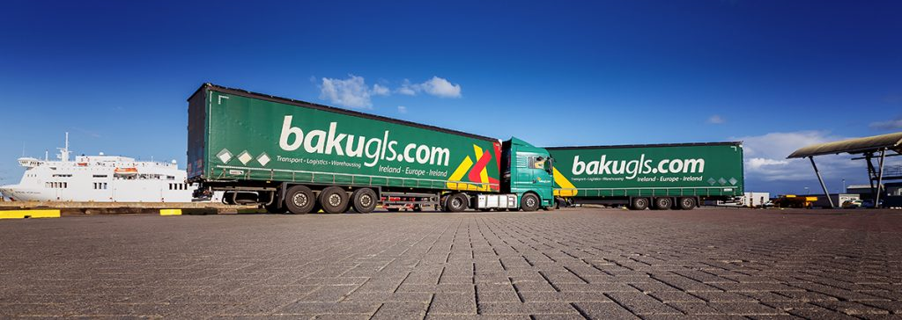
The Transport People Offering Service beyond Logistics
www.bakugls.com

